Slide 1

Website Flow

Slide 2

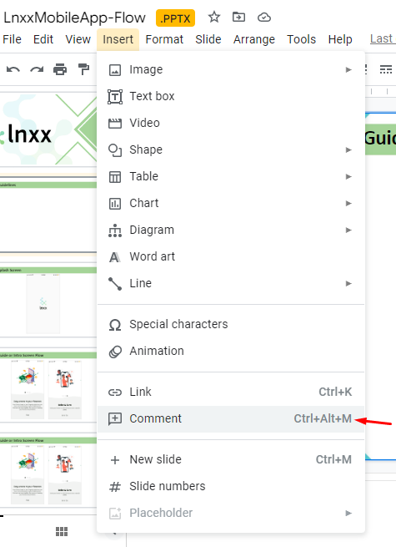
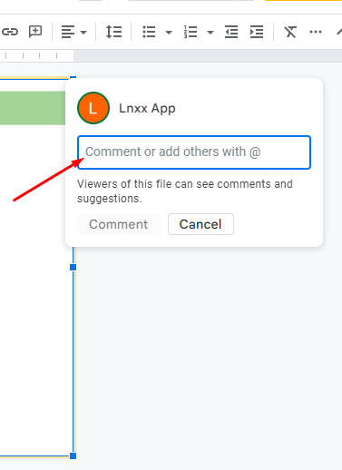
Guide to add your comment on any screen
Go to insert option
Click on comment option
Then it will show a comment popup option
Then you can add your comment on any screen
Then click on comment button to save your comment

Slide 3

1
Landing Page

Slide 4
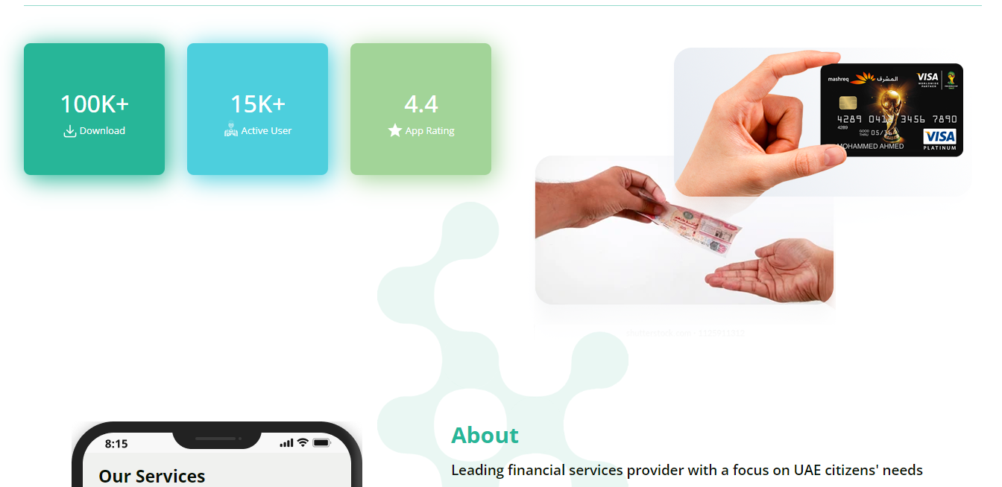
2
Landing Page – continue…

Slide 5

3
Landing Page – continue…

Slide 6
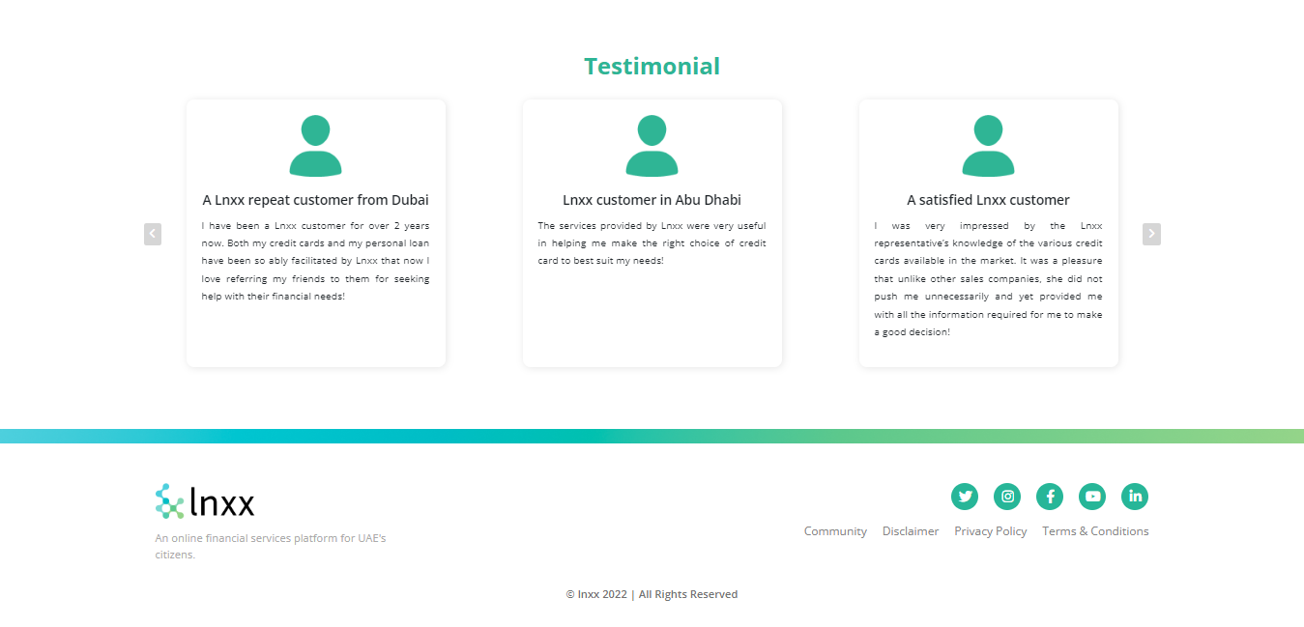
4
Landing Page – continue…

Slide 7

5
Customer Landing Page –

Slide 8

6
Customer Landing Page – continue…

Slide 9

7
Customer Landing Page – continue…

Slide 10

8
Customer Landing Page – continue…

Slide 11
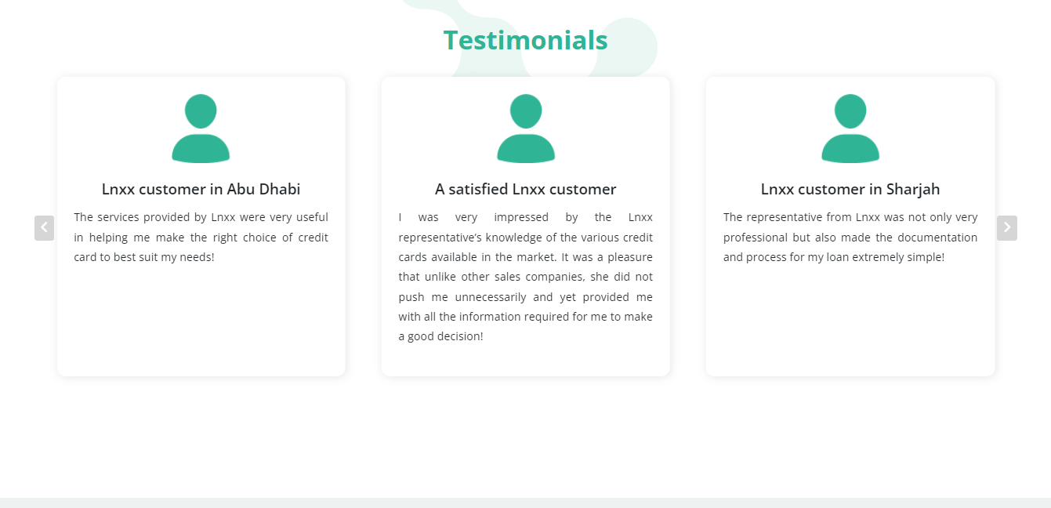
9
Customer Landing Page – continue…

Slide 12
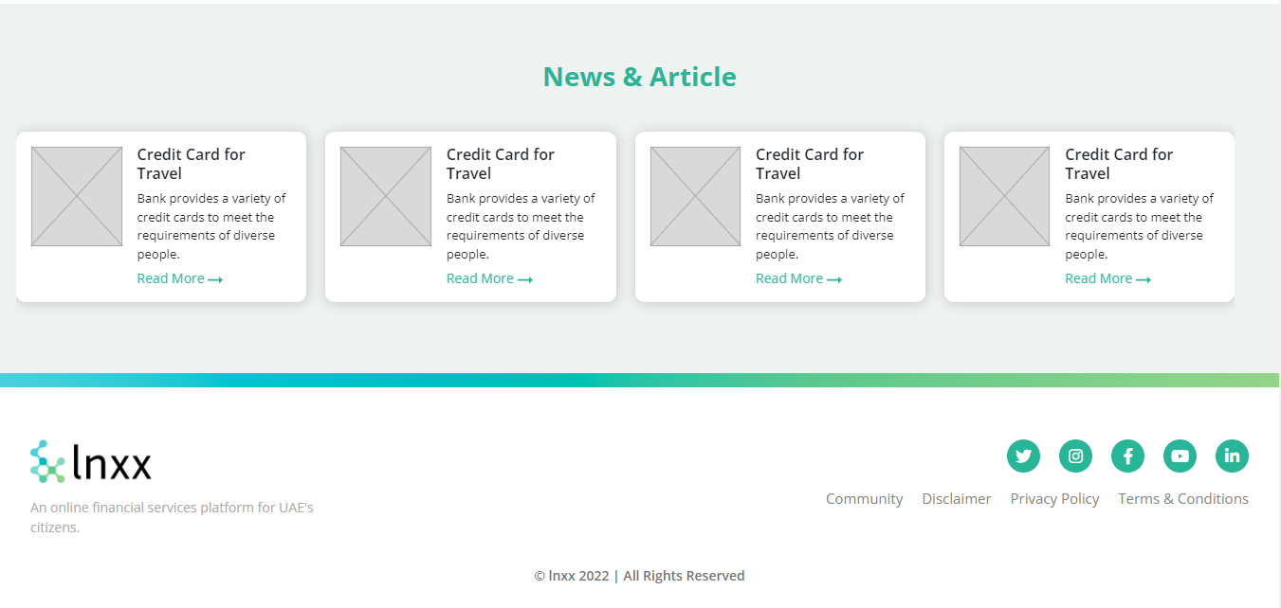
10
Customer Landing Page – continue…

Slide 13
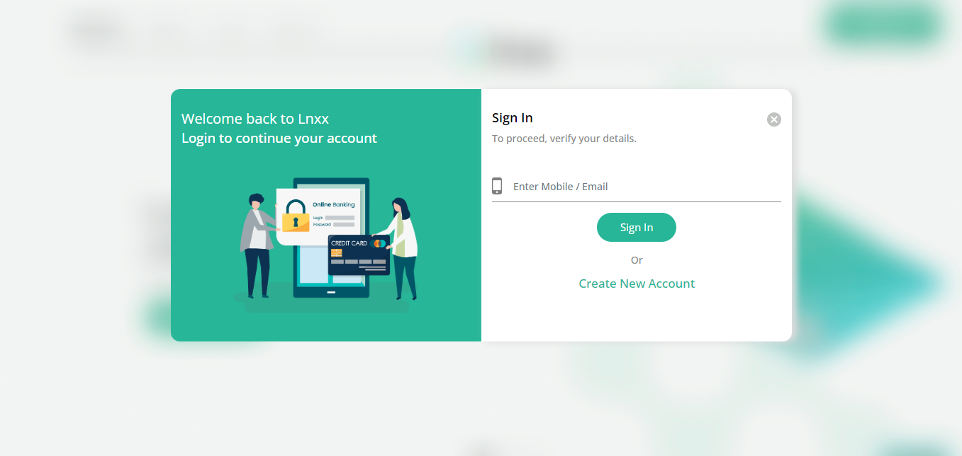
11
Customer sign in page

Slide 14

12
Customer sign up page -

Slide 15

13
Customer sign up page - Continue…

Slide 16

14
Customer sign up page - Continue…

Slide 17

15
Customer sign up page - Continue…

Slide 18
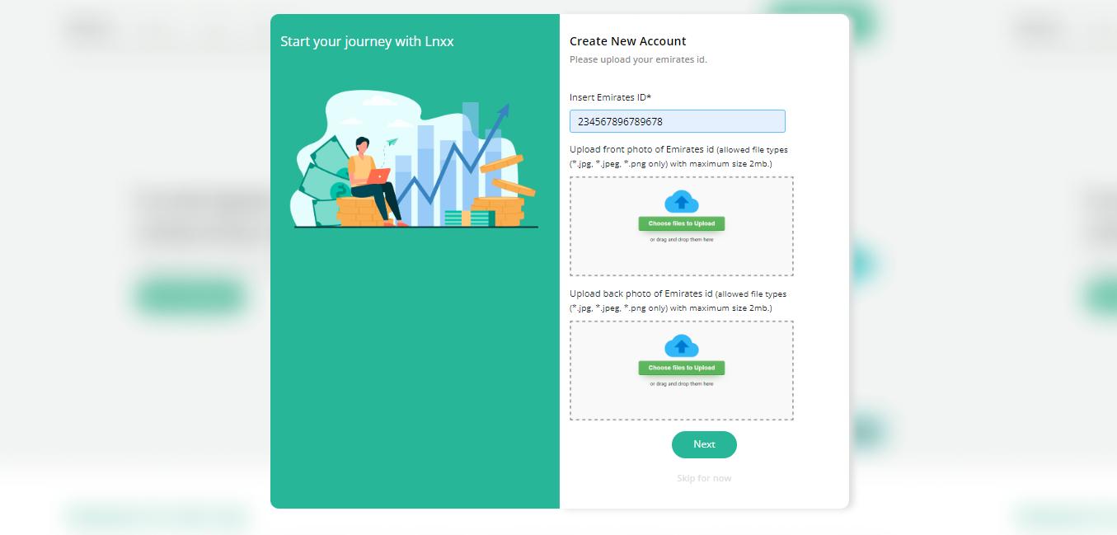
16
Customer sign up page - Continue…

Slide 19

17
Customer sign up page - Continue…

Slide 20

18
Customer sign up successfully done

Slide 21
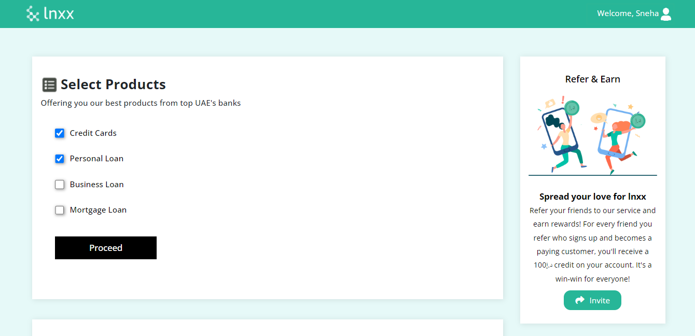
19
Customer dashboard page -

Slide 22
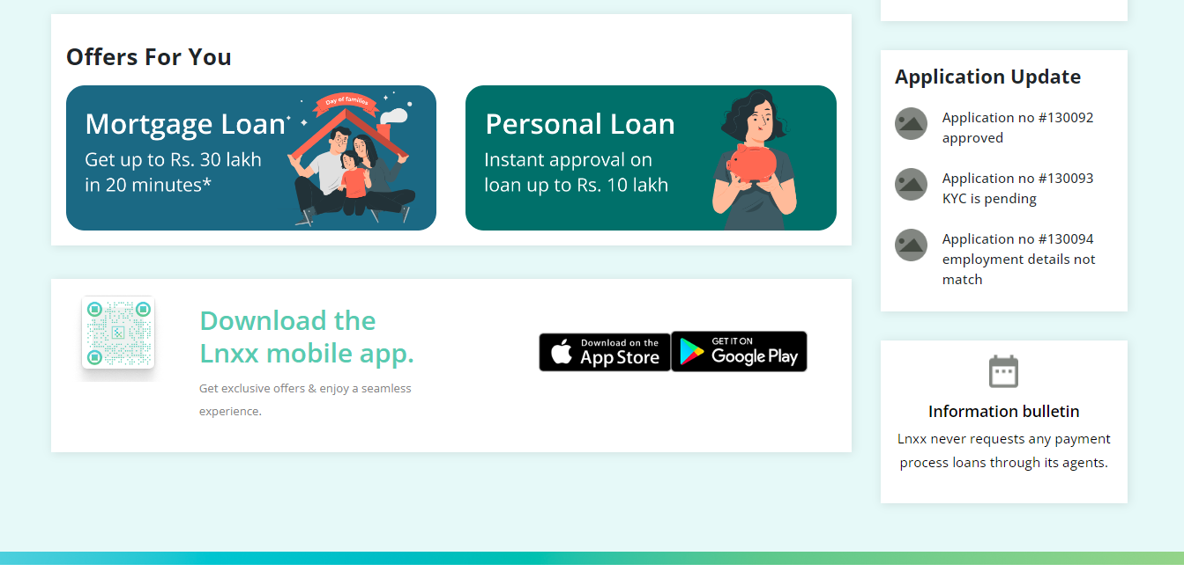
20
Customer dashboard continue…

Slide 23
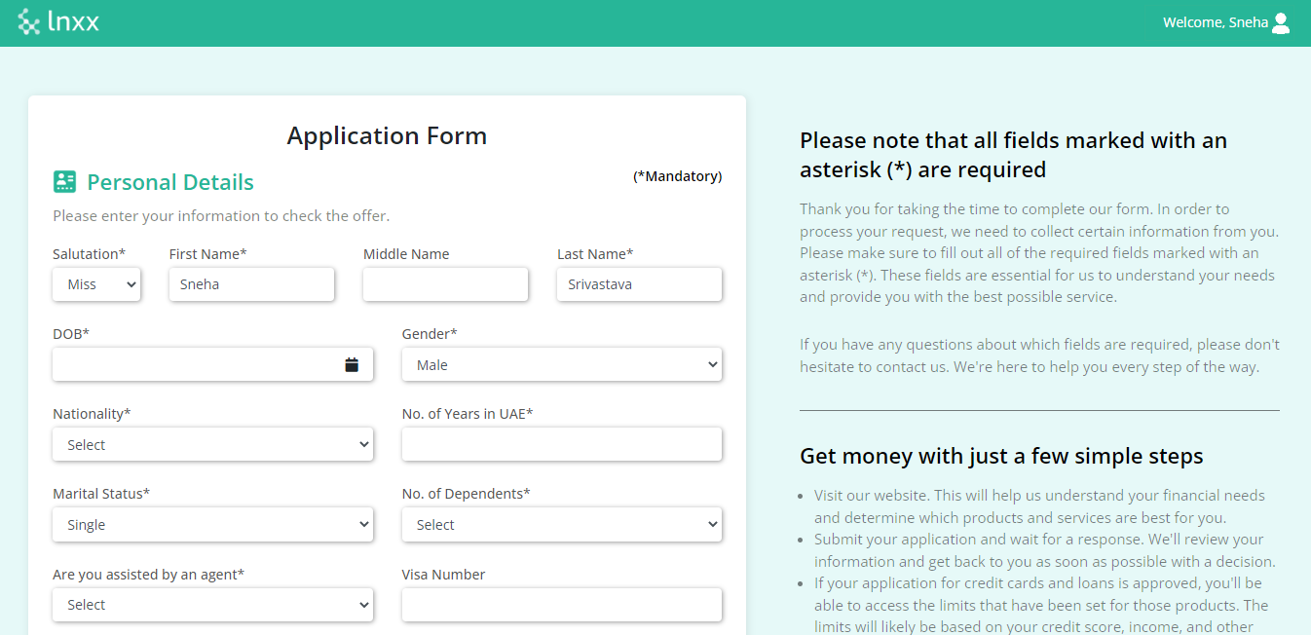
21
Application Form Personal Details Page -1

Slide 24
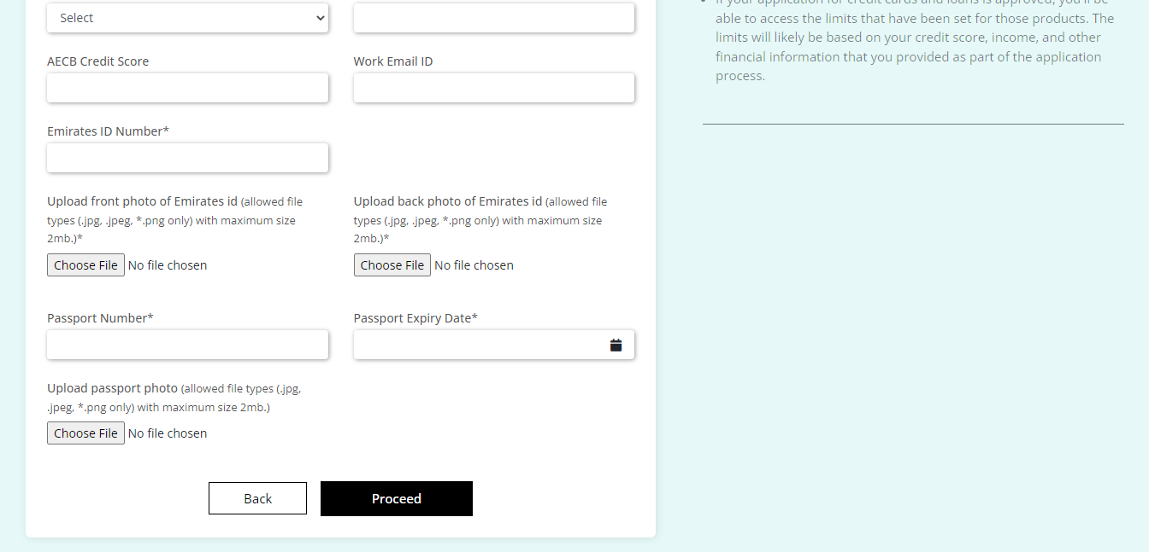
22
Application Form Personal Details Page -1

Slide 25
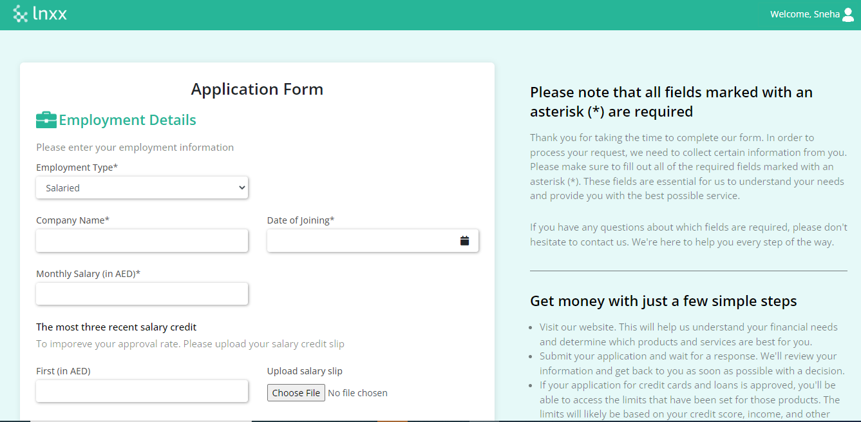
24
Application Form Employment Details (salaried) Page -3

Slide 26
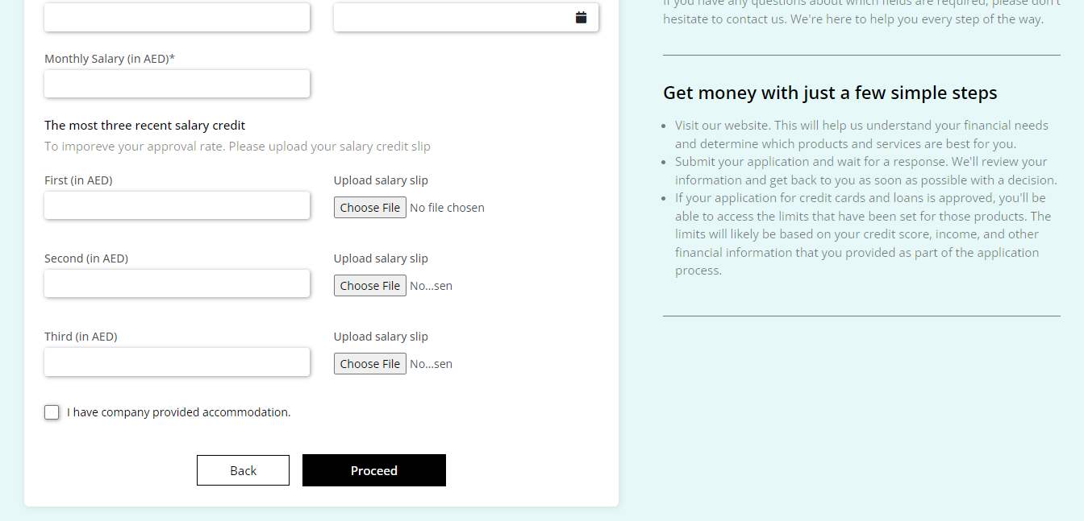
25
Application Form Employment Details (salaried) Page -3

Slide 27
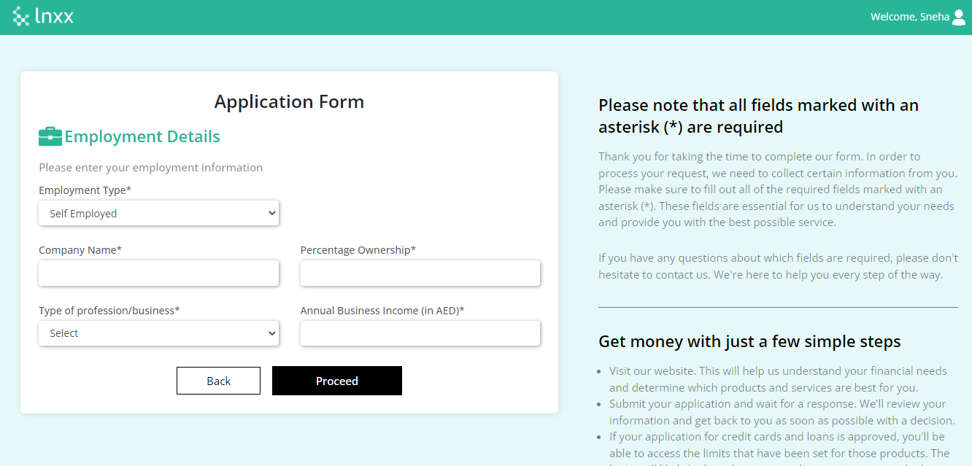
26
Application Form Employment Details (self employee) Page -3

Slide 28
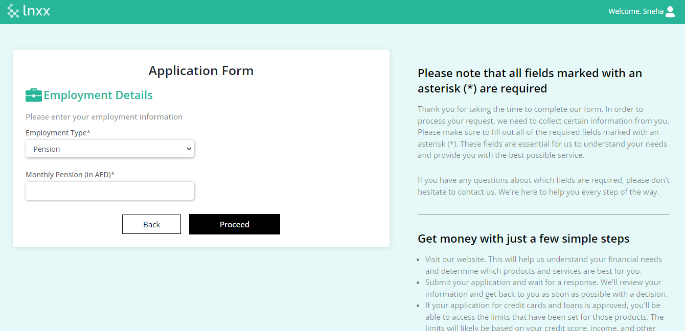
27
Application Form Employment Details (pension) Page -3

Slide 29
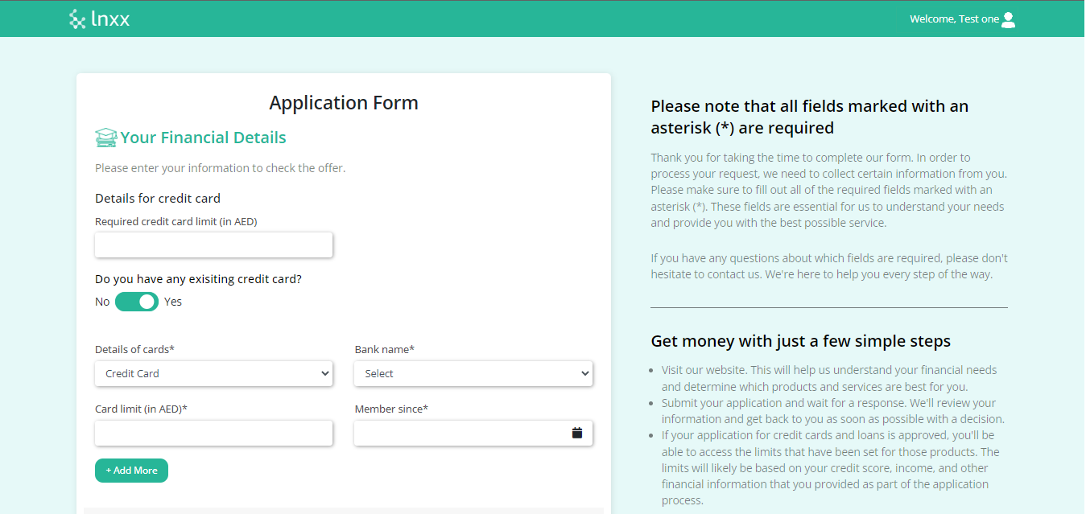
28
Application Form Financial Details Page -4

Slide 30
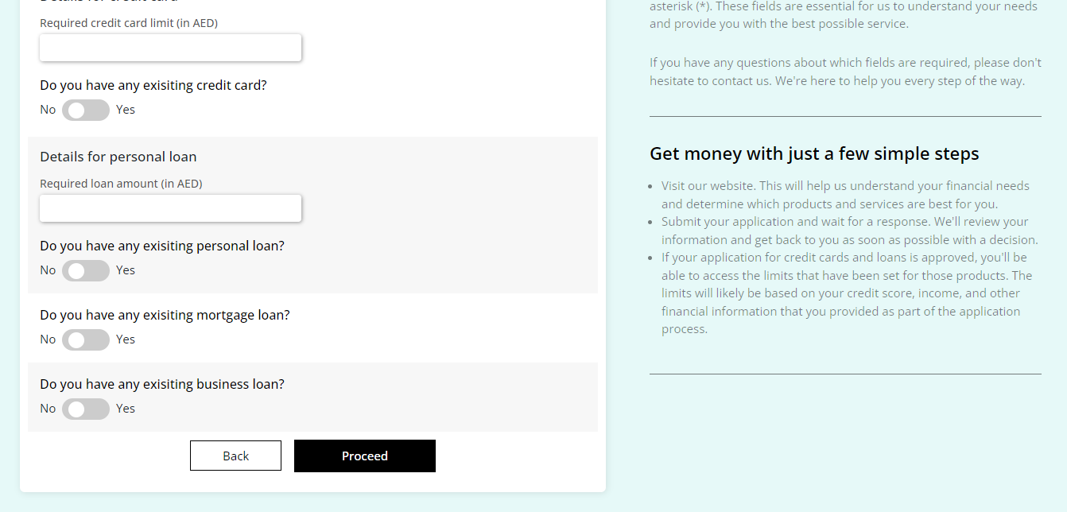
29
Application Form Financial Details Page -4

Slide 31
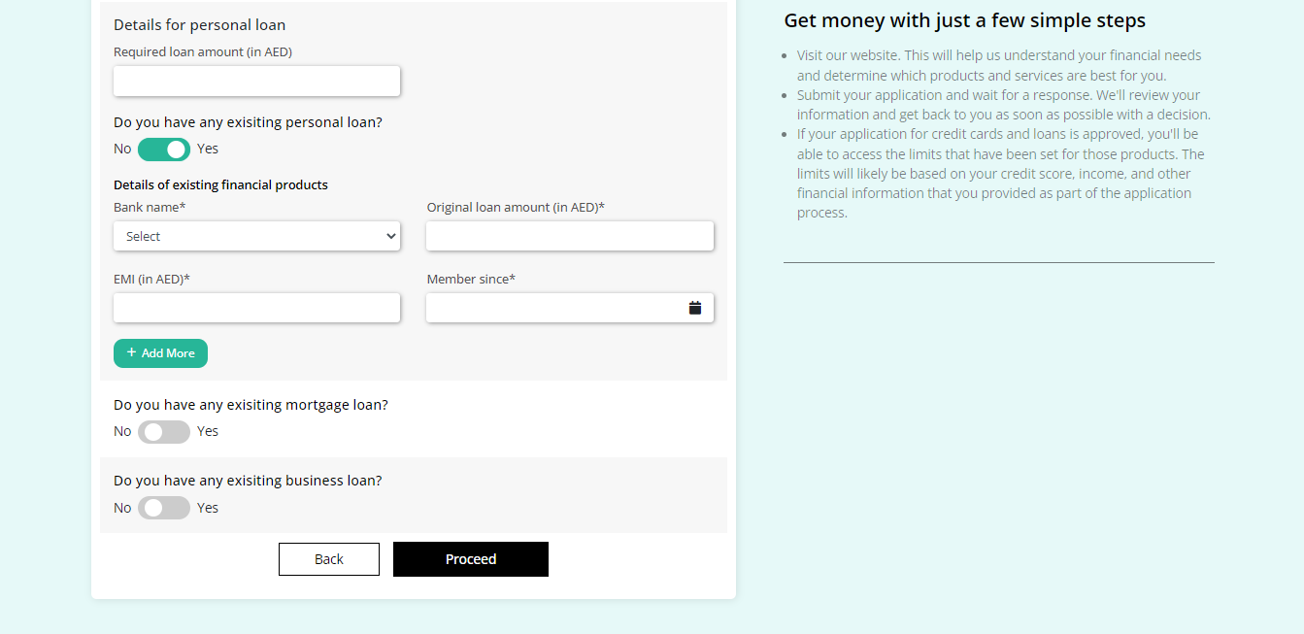
30
Application Form Financial Details Page -4

Slide 32
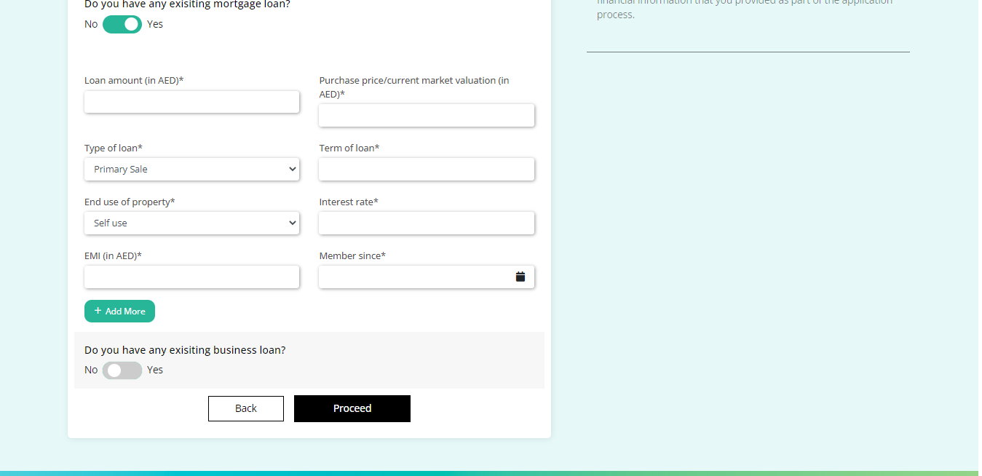
31
Application Form Financial Details Page -4

Slide 33
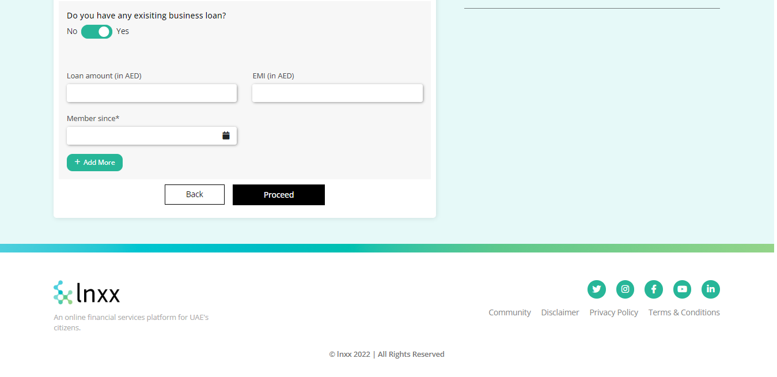
32
Application Form Financial Details Page -4

Slide 34
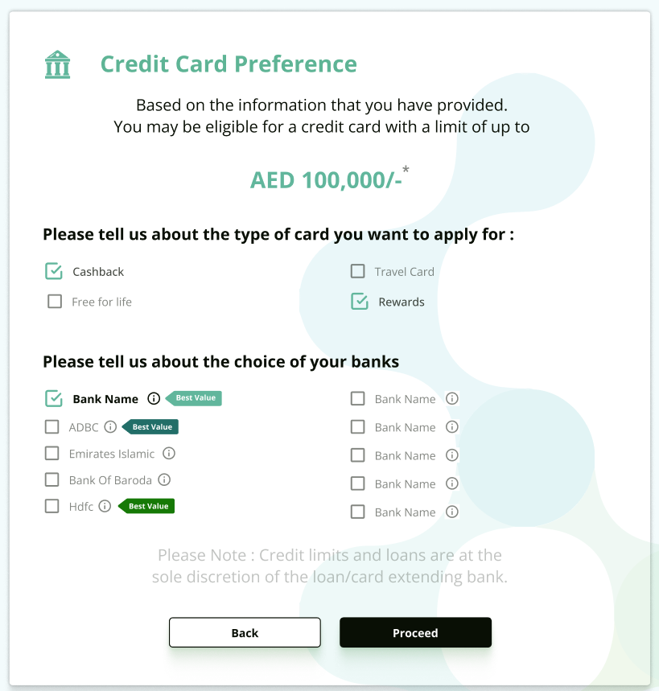
33
Application form card preference Page -5

Slide 35
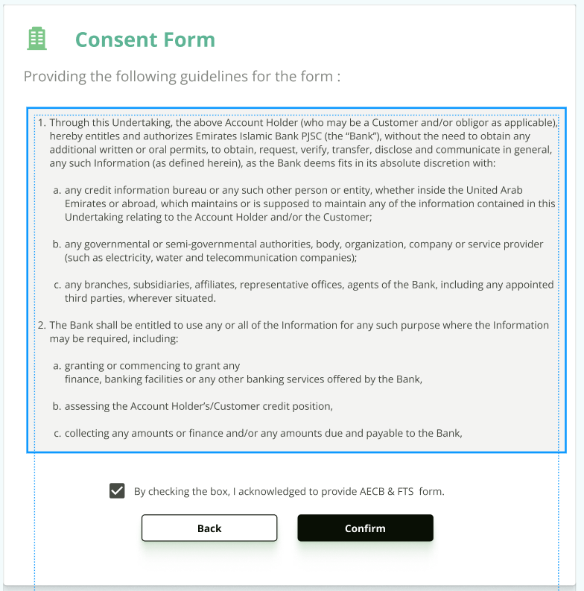
34
Application Form Consent Form Page -6

Slide 36
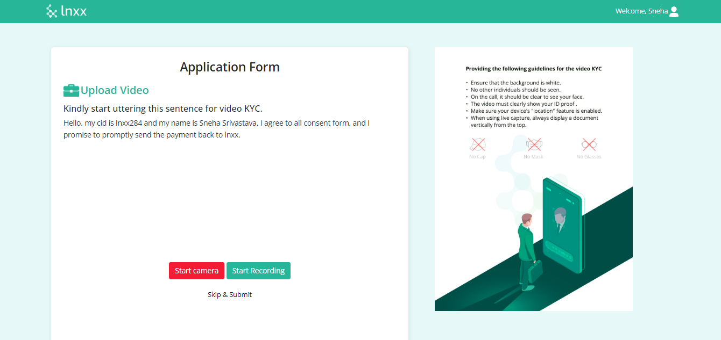
35
Application Form Upload video KYC Page -7

Slide 37

36
Application Form- first step completion message Page -8

Slide 38

36
Application Form (on click of i will do later) Page -8

Slide 39
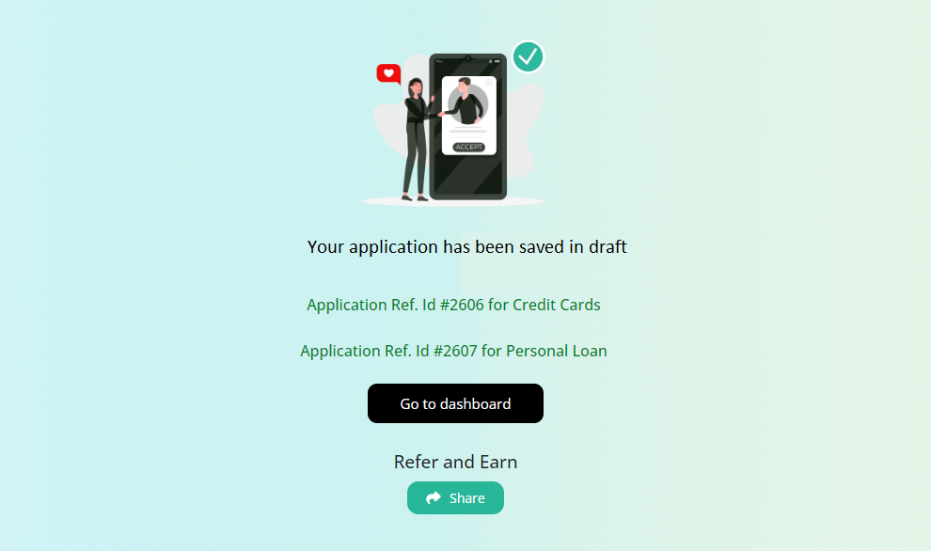
36
Application Form (Reference Id) Page -9

Slide 40
THANK YOU!

